Slide 1
OGC ISG Sprint Kickoff Presentation:
Steinbeis Technology Transfer at HFT Stuttgart
Prof. Dr. Volker Coors
September 1, 2020

Slide 2
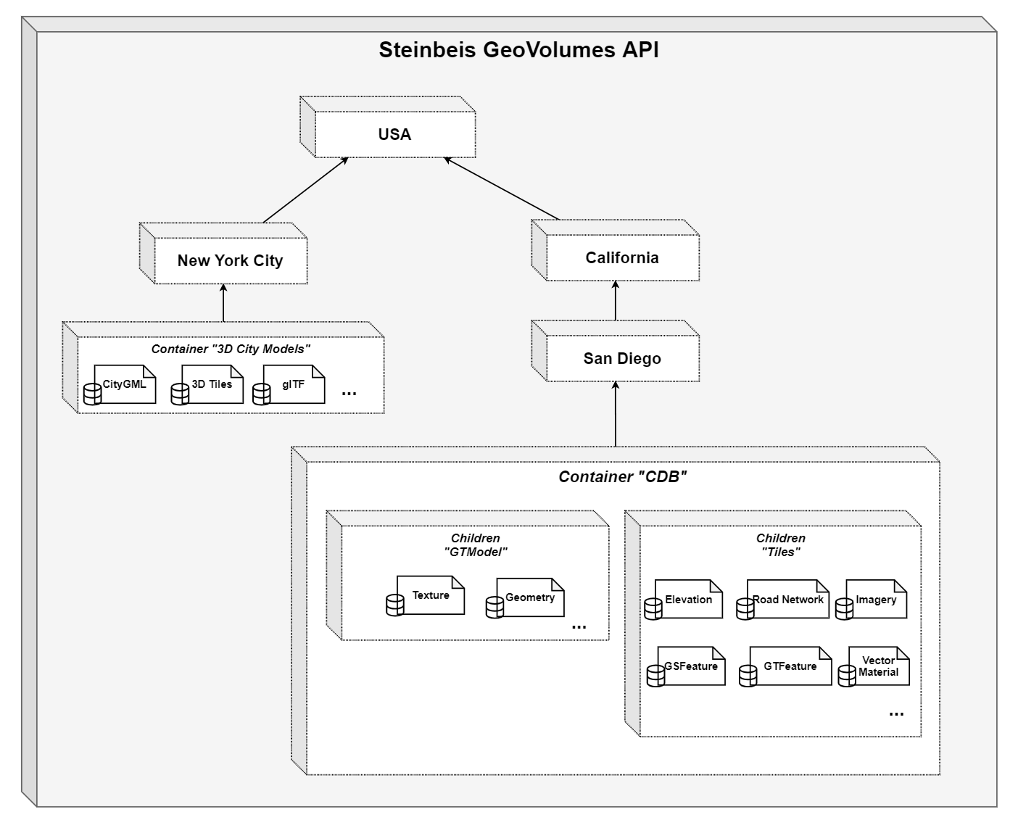
GeoVolume API Server extending 3D Container Pilot results
Server developed in 3D Container Pilot: http://steinbeis-3dps.eu:8080/3DContainerTile/
Test and evaluate the different organization of the underlying 3D data at the server.
Organize the data on the server in one single bounding volume hierarchy (Test data: San Diego data set, CityGML LoD 1 California)
Organize the data on the server in multiple bounding volume hierarchies per county and city (Test data CityGML LoD 1 California)
Organize the data on the server in multiple bounding volume hierarchies per feature (buildings, road network, etc.), following the current CDB structure (Test data: San Diego data set)
Integration of Sensor data via Sensor Things API from 3D IoT Pilot (optional)

Slide 3
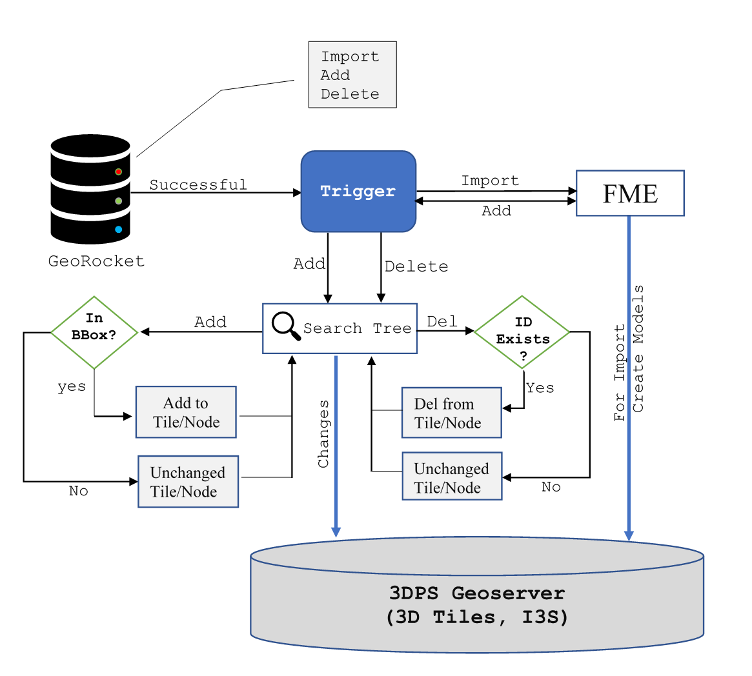
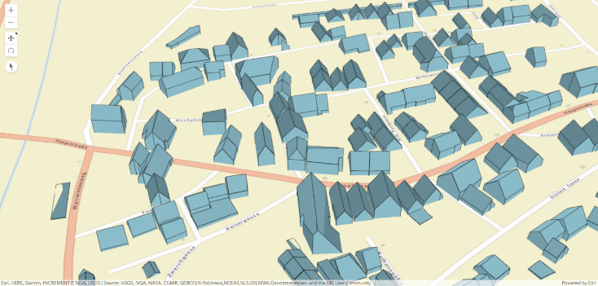
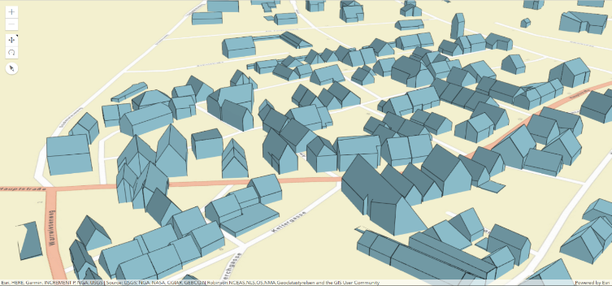
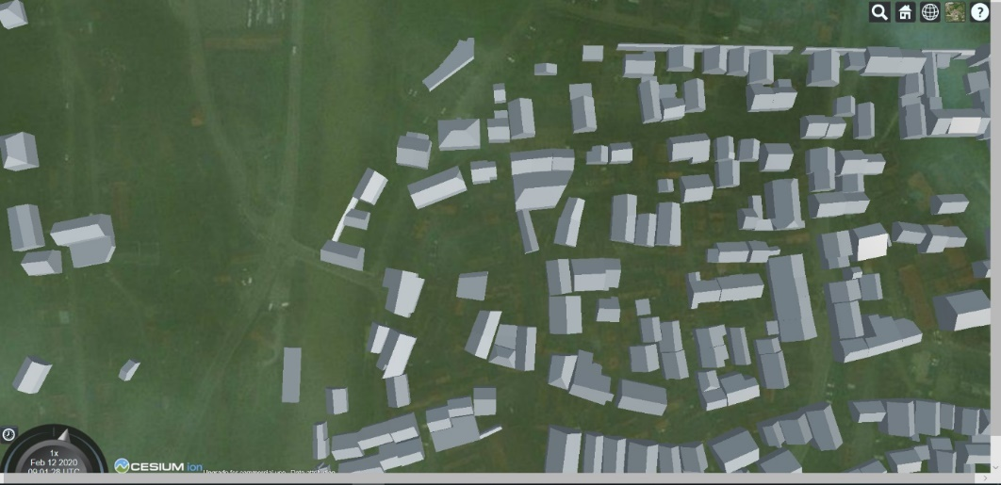
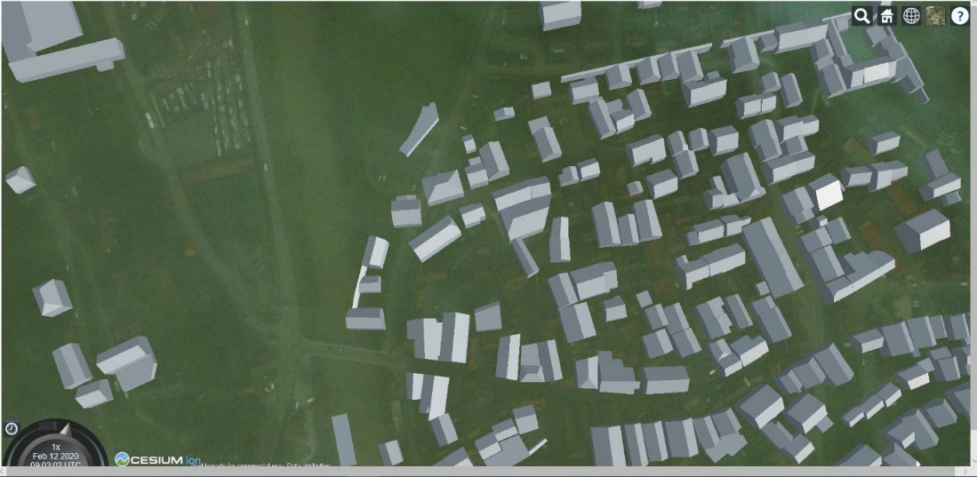
Model update
ESRI client rendering I3S data. Right image shows a new building added to the existing I3S dataset
Cesium client rendering 3D Tiles data. Right image shows a new building added to the existing 3D Tile dataset.
A short demonstration https://youtu.be/-r-q4n7-b30

Slide 4
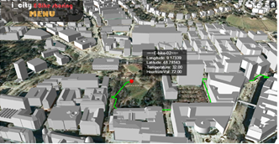
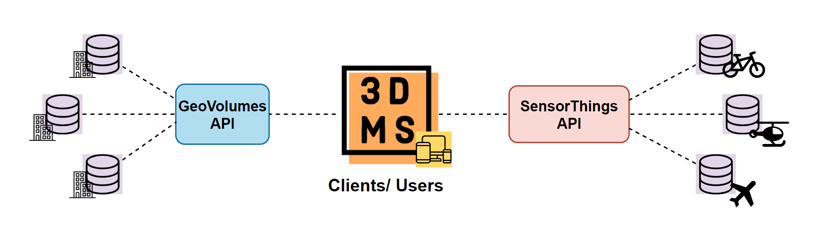
Scenario (optional)
Do we need a scenario?
Proposal: 3D Mobility Simulator
Urban air taxi sharing

Slide 5

The team
Volker Coors (Concepts and Writing)
Thunyathep (Joe) Santhanavanich (GeoVolume API & SensorThings API)
Patrick Würstle (GeoVolume API)
Harpreet Singh (Model Update)
Martin Storz (Unity)
http://steinbeis-3dps.eu
volker.coors@stw.de

